Slide 1

CSE3251
Computer Networks
Dr. Asif Zaman
Professor, CSE, RU

Slide 2
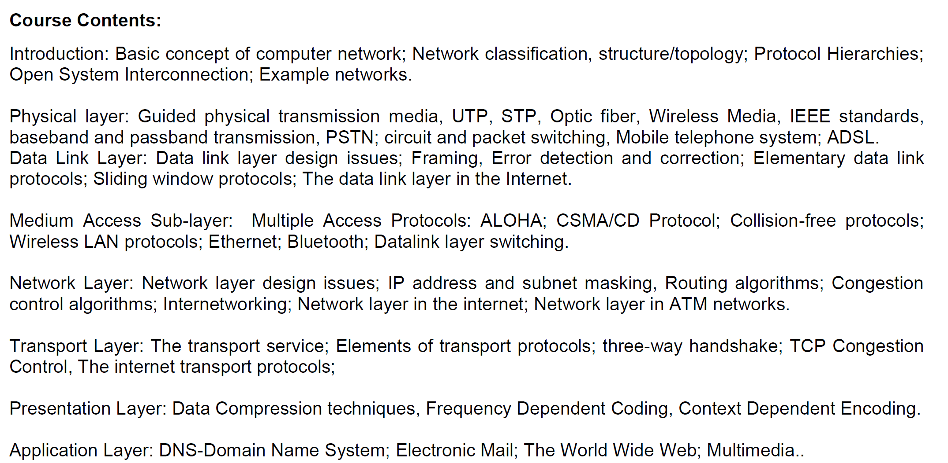

Slide 3
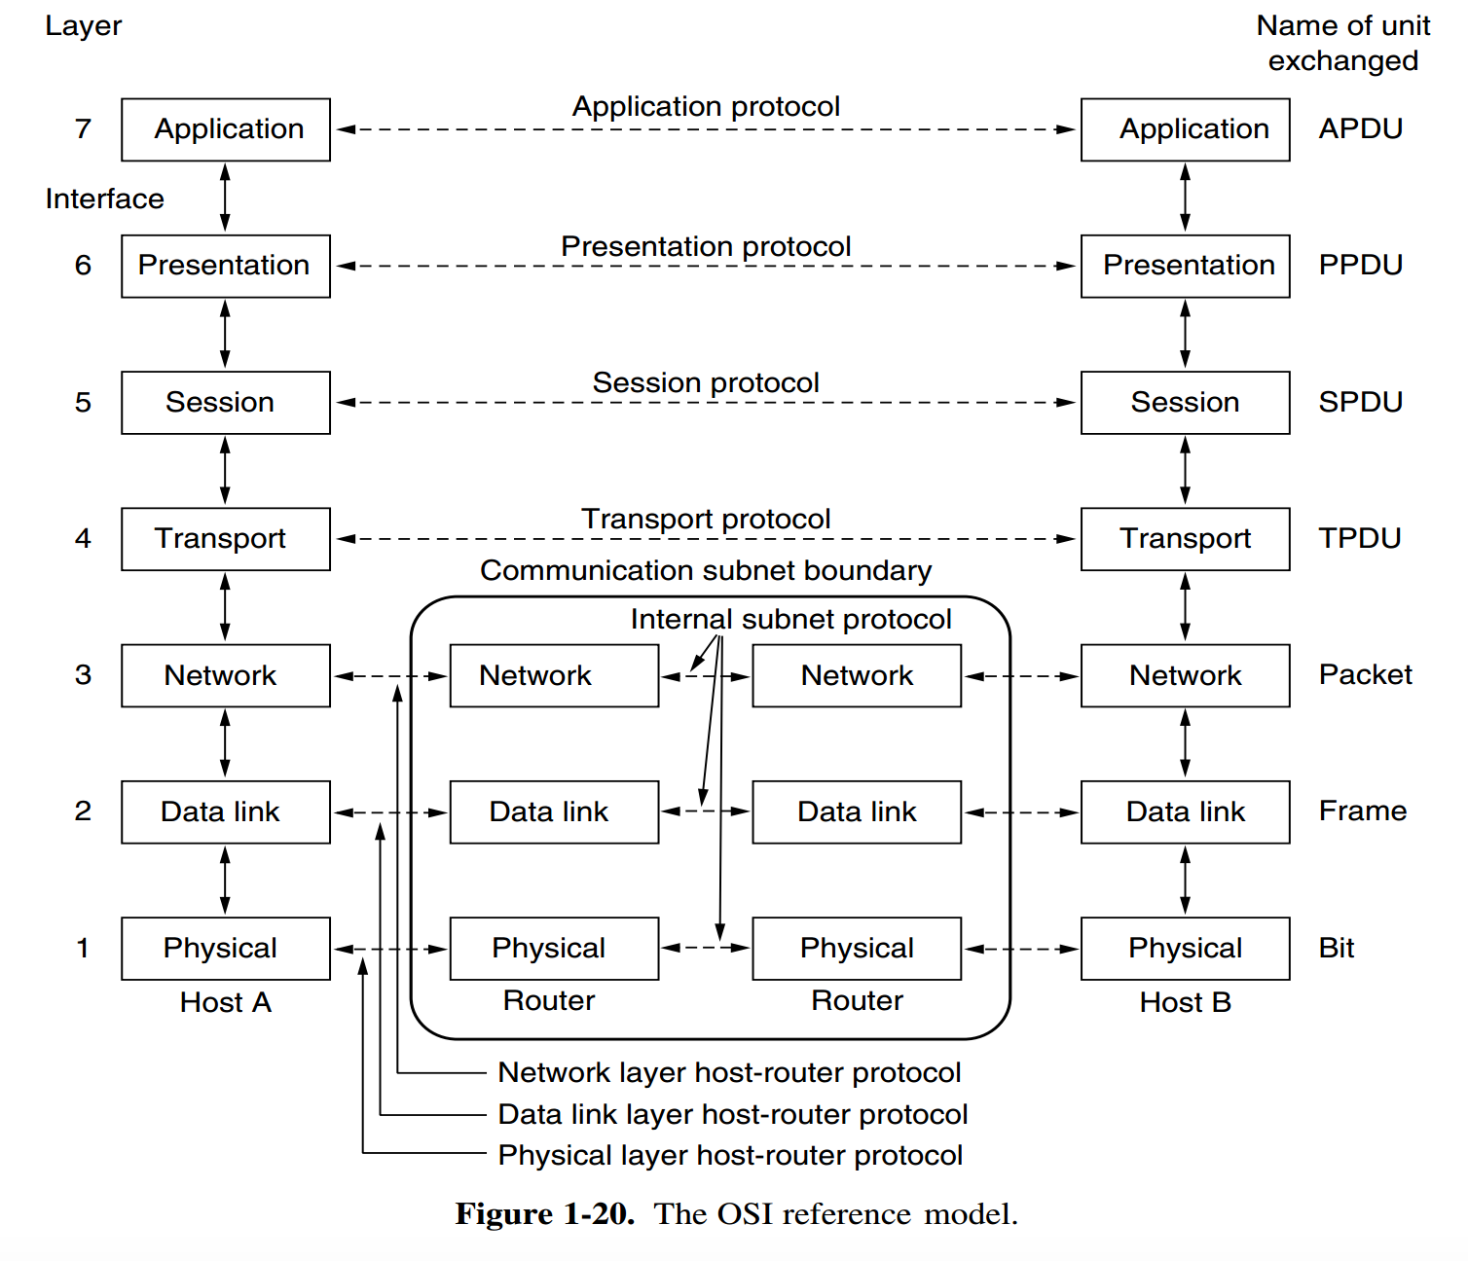
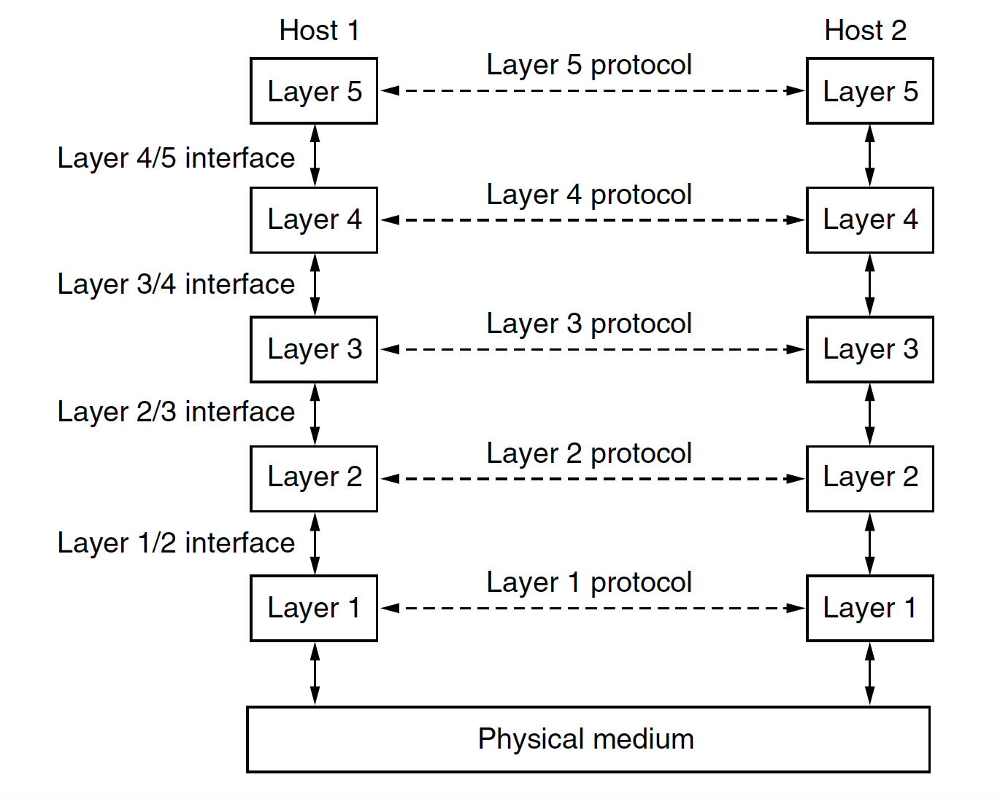
OSI Reference Model
All People Seem To Need Data Processing

Slide 4
NIC
Network Interface Card
Characteristics of NIC
Physical network address
Media Access Control (MAC) address.
MAC addresses are six bytes long
00-00-86-47-F6-65
Network connection port
Status indicator lights

Slide 5
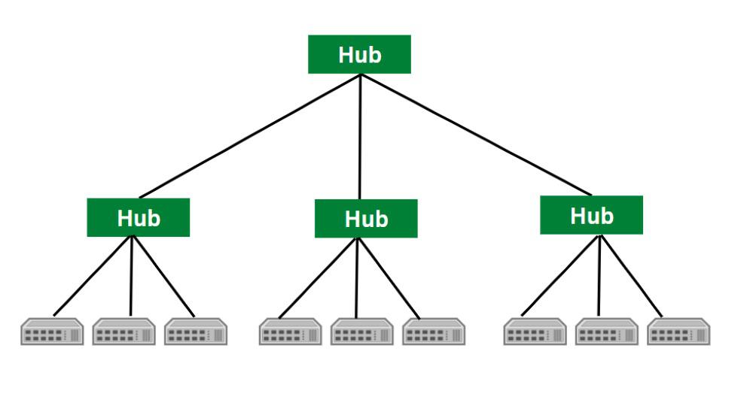
Hub & Repeater
What is a Hub?
Types of Hub
Active Hub: … requires an external power supply
Passive Hub
Intelligent Hub
https://www.geeksforgeeks.org/difference-between-hub-and-repeater/

Slide 6
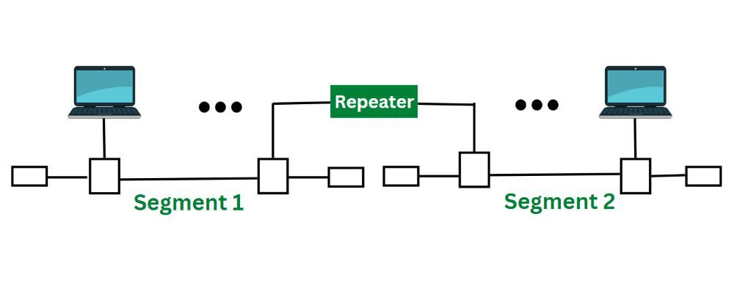
Hub & Repeater
What is a Repeater?
Types of Repeater
Analog Repeater:
Digital Repeater:
Can we use Hub or Repeater for securing our Network?
Is there any alternative for Hub and Repeater?
Explain why the repeater is known as a level-1 relay.
Are the switch and repeater the same?

Slide 7
Transceiver
A transceiver is a TRANSmitter – receiver
Mechanical Device
Types of Transceivers
RF Transceivers
Fiber Optic Transceiver
Ethernet Transceivers
Wireless Transceivers

Slide 8
Transceiver
Key Features and Functions of Transceivers
Modulation and Demodulation:
Modulation involves encoding data onto a carrier signal for transmission, while demodulation extracts the original data from received signals.
Signal Amplification:
Frequency Conversion:
Signal Encoding/Decoding:
https://www.geeksforgeeks.org/transceivers/

Slide 9
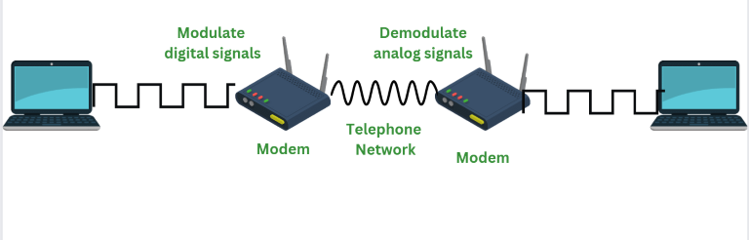
Modem
Modulation + Demodulation

Slide 10
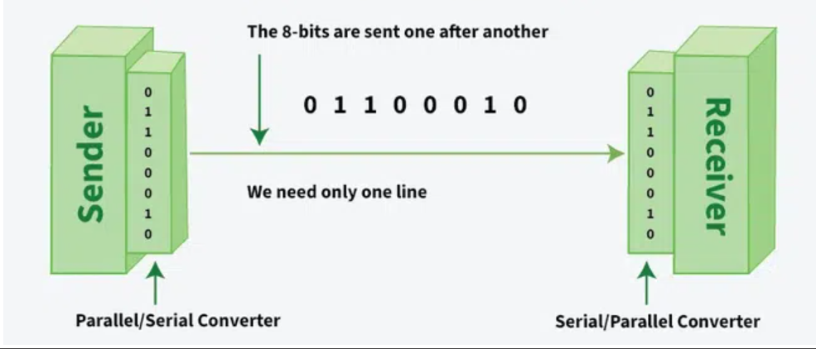
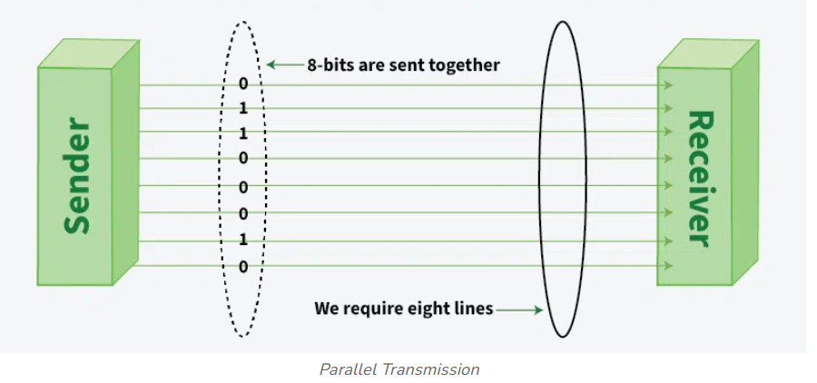
Serial vs Parallel Transmission

Slide 11
Mobile Phone System
Mobile phones should not be confused with cordless phones
…. it is interesting to note how political and tiny marketing decisions can have a huge impact.

Slide 12
US vs Europe
Purchased in California also worked in New York
Europe, every country devised its own system, which resulted in a fiasco (mess/ disaster).
In the U.S., mobile phones are mixed in with regular (fixed) telephones – (212) 234-5678
In Europe, mobile phone numbers have a special area code (analogous to 800 and 900 numbers)
…prepaid mobile phones in Europe (up to 75% in some areas).

Slide 13
Mobile Phone System
Mobile phones (sometimes called cell phones) three distinct generations, widely called 1G, 2G, and 3G. The generations are:
Analog voice.
Digital voice.
Digital voice and data (Internet, email, etc.)

Slide 14
First-Generation (1G) Mobile Phones: Analog Voice
In 1946, the first system for car-based telephones was set up in `.
…single large transmitter on top of a tall building +
had a single channel, used for both sending and receiving.
push-to-talk systems
In the 1960s, IMTS (Improved Mobile Telephone System)
IMTS supported 23 channels … from 150 MHz to 450 MHz.

Slide 15
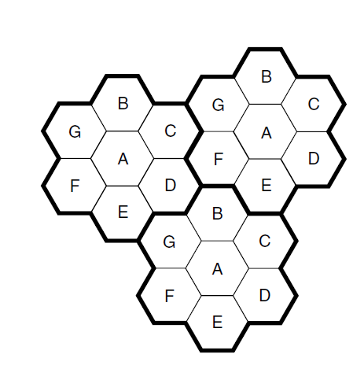
Advanced Mobile Phone System (AMPS)- Bell labs
Installed in 1982
Europe – TACS
Japan – MCS-L1
Retired 2008
A geographic region is divided up into cells
In AMPS, the cells are typically 10 to 20 km across;
in digital systems, the cells are smaller
The key idea that gives cellular systems more capacity than previous systems is the use of relatively small cells and the reuse of transmission frequencies in nearby (but nonadjacent) cells.

Slide 16
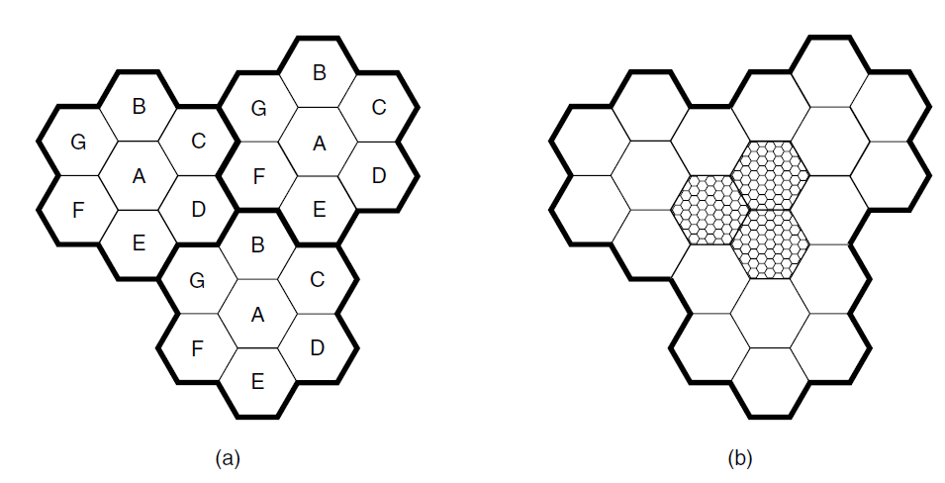
The cells are normally roughly circular, but they are easier to model as hexagons
They are grouped in units of seven cells.
Each letter indicates a group of frequencies.
Notice that for each frequency set, there is a buffer about two cells wide where that frequency is not reused, providing for good separation and low interference

Slide 17
At the center of each cell is a base station to which all the telephones in the cell transmit.
The base station consists of a computer and transmitter/receiver connected to an antenna.
In a small system, all the base stations are connected to a single device called an MSC (Mobile Switching Center) or MTSO (Mobile Telephone Switching Office).
In a larger one, several MSCs may be needed, all of which are connected to a second-level MSC, and so on.
The MSCs are essentially end offices as in the telephone system, and are in fact connected to at least one telephone system end office.

Slide 18
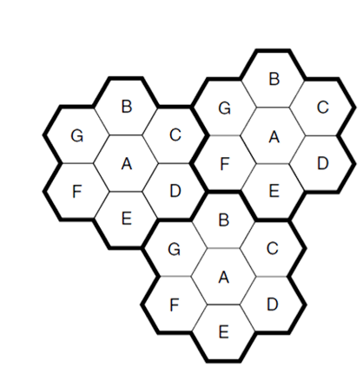
At any instant, each mobile telephone is logically in one specific cell and under the control of that cell’s base station.
When a mobile telephone physically leaves a cell ….
….the base station then transfers ownership to the cell getting the strongest signal;
The telephone is then informed of its new boss,…
This process, called handoff, takes about 300 msec.
Channel assignment is done by the MSC, the nerve center of the system.
The base stations are really just dumb radio relays.

Slide 19
AMPS uses FDM to separate the channels
..832 full-duplex channels,
…824 to 849 MHz are used for mobile to base station,
… 869 to 894 MHz are used for base station to mobile
…is 30 kHz wide
The 832 channels are divided into four categories
Control channels (base to mobile) are used to manage the system.
Paging channels (base to mobile) alert mobile users to calls for them.
Access channels (bidirectional) are used for call setup and channel assignment.
Finally, data channels (bidirectional) carry voice, fax, or data.

Slide 20
Second-Generation (2G) Mobile Phones: Digital Voice
1G: Analog voice 2G: Digital voice
It provides capacity gains by allowing voice signals to be digitized and compressed.
It improves security by allowing voice and control signals to be encrypted.
Finally, it enables new services such as text messaging
…no worldwide standardization during the second
DAMPS (Digital Advanced Mobile Phone System) - coexists with AMPS and uses TDM to place multiple calls on the same frequency channel

Slide 21
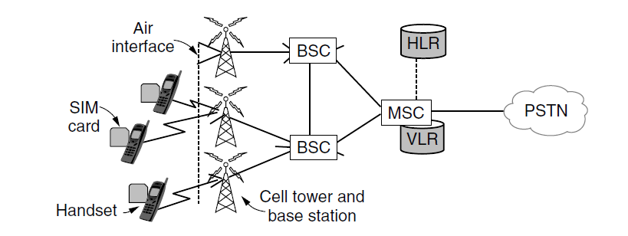
GSM (Global System for Mobile communications) –Europe
CDMA (Code Division Multiple Access) - US
SIM card, short for Subscriber Identity Module
BSC (Base Station Controller)
BTS - Base Transceiver Station
VLR (Visitor Location Register)- database of nearby mobiles that are associated with the cells it manages
HLR (Home Location Register) - a database in the mobile network that gives the last known location of each mobile.

